Slide 1

Unit Testing
M1-D14
Participate! The more engagement the better! You are NEVER interrupting me!

Slide 2
Objectives
Software Development Lifecycle (SDLC) (Waterfall vs Agile)
Software Testing Overview
Unit Testing
Unit Testing with JUnit
Code Coverage
TDD / Katas (Time Permitting)

Slide 3
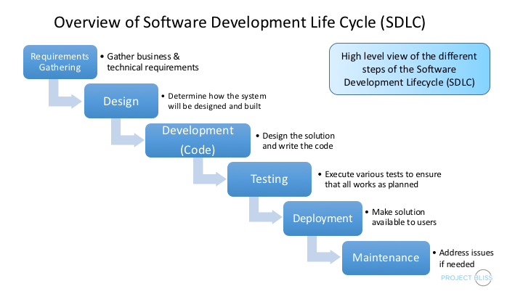

Slide 4
Agile Manifesto
Individuals and interactions MORE IMPORTANT THAN process and tools
Working software MORE IMPORTANT THAN comprehensive documentation
Customer collaboration MORE IMPORTANT THAN contract negotiation
Responding to change MORE IMPORTANT THAN following a plan
Original Agile Manifesto

Slide 5
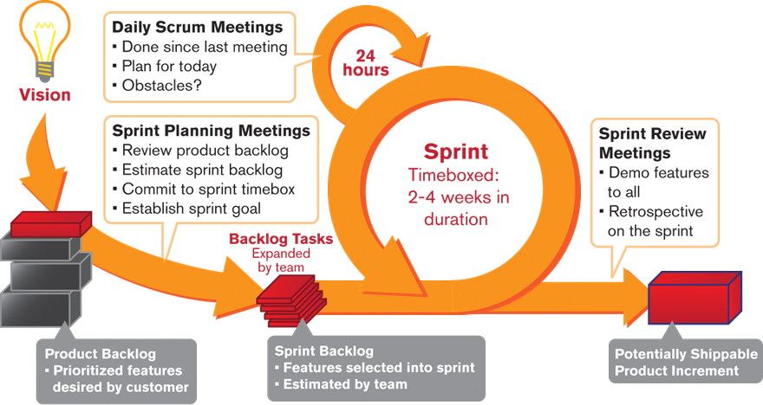
Concepts
Daily Standups
Spring Planning
Retrospectives
Sprint Review

Slide 6
Software Testing
Manual | Automated
Done by humans | Done by computer automation
Creativity | Speed / Efficiency
Subjectivity | Lower cost per execution
 | Repeatability / Dependability
 | Accuracy
Exploratory Testing - explores the functionality of the system looking for defects, missing features, usability, or other opportunities for improvement. Almost always manual.
Regression Testing - validates that existing functionality continues to operate as expected, as new new functionality is added and defects are resolved. Usually automated.

Slide 7
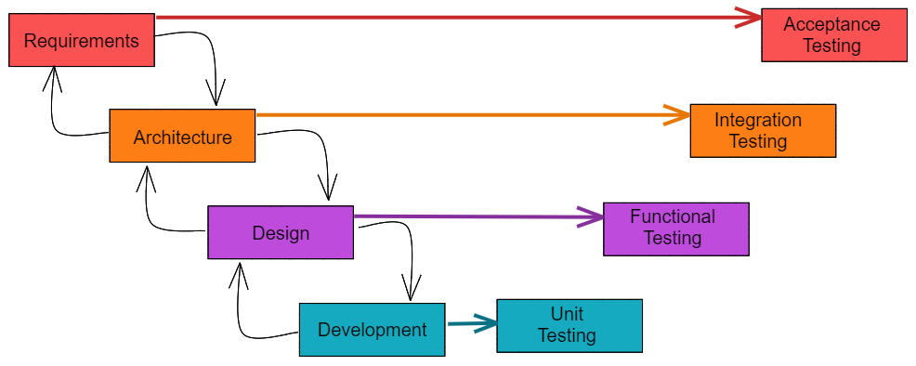
Acceptance Testing is performed from the perspective of a user of a system in order to verify the requirements have been satisfied.
Integration Testing is a broad category of tests that validate integration between units of code or code and outside dependencies such as a database, network resource, or file.
Functional Testing validates that the functional design has been satisfied
Unit Testing is low level testing performed by the programmer to validate that individual units of code function as expected by the programmer.

Slide 8
Some Other Types of Testing
Some Testing Roles
Performance
Scalability
Usability
Accessibility
Portability
Smoke / Sanity
Alpha
Beta
Stress
Security
Non-Functional
Developer (Unit Test)
QA (Quality Assurance)
QC (Quality Control)
Automation Developer
Manual Tester

Slide 9
STOPPING POINT FOR INHERITANCE - PT2 DAY

Slide 10
Unit Tests
Should be:
Fast
Repeatable
Independent
Obvious
Steps:
Arrange (Setup)
Act (Test)
Assert (Verify)
Rules:
No external dependencies
On logical assertion per test
Test code should be the same quality as product code
Test early, test often
Don’t save them for the end

Slide 11
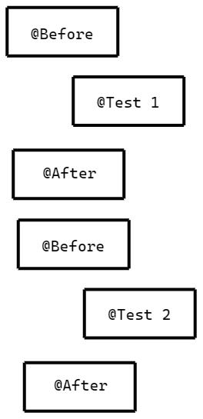
JUnit
JUnit is a Java Framework for writing and running Unit Tests.
Package: org.junit
The life cycle of JUnit tests are controlled by annotations on public methods in the class.
@Before - runs before each test, to do setup
@Test - runs as the test
@After - runs after each test to cleanup
@Before
public void setup() { }
@Test
public void test_something() { }
@After
public void cleanup() { }

Slide 12
org.junit.Assert
The Assert class allows verification of results. Some examples:
Assert.assertTrue( optionalMessage, booleanCondition )
Assert.assertFalse( optionalMessage, booleanCondition )
Assert.assertEquals( optionalMessage, expectedValue, actualValue )
Assert.assertEquals( optionalMessage, expectedDouble, actualDouble, precision )
Assert.fail()
Asserts can be in the test method or any private methods that it calls!

Slide 13
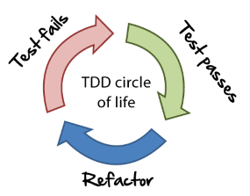
Test Driven Development (TDD)
TDD Circle of Life
Write failing test
Make test pass with minimum code
Refactor
Repeat

Slide 14
TDD Strategy
Create a list of tests needed.
Start by writing just enough test code
Always run the test to see it fail in the way you expect
Write enough code to make the test build
Write enough code to make that test pass
If you can’t solve it, fake it!
When the implementation is obvious then continue, if it is not then go back to #4
Refactor
TDD allows the problem to be worked on in 2 parts, the problem and the code. First you solve the problem without regard to code quality, then once the problem is solved you use the passing test cases to improve code quality with constant feedback regarding whether the problem is still being solved.

Slide 15
Refactoring
Refactoring introduces modifications to the code intended to improve the structure or design without changing functionality.
Simple Ways to refactor
Eliminate duplicate code
Extract a method by breaking down long difficult methods
Extract complex operations to variables
Introduce constants for magic numbers
Simplify conditional expressions
Article on Refactoring

Slide 16
Katas
A code kata is an exercise in programming which helps programmers hone their skills through practice and repetition.
TDD is a common method used to solve code katas to allow first focusing on the problem and then being able to focus on the quality of the code and experimentation with new ideas.
Why do Code Katas?
Practice
Improves Coding Skills
Improves Problem solving
Companies use them as part of the interview process
They can be fun!
A few places to find Katas
Awesome Katas
Code Wars
Code Kata
Code Abbey
Coding Dojo

Slide 17
TDD Steps for an interview Kata
Figure out what tests you need to meet the requirements
Pick a test and write it - fail it.
Git add/commit
Write just enough code to pass the test
Git add/commit
Refactor if needed
Add more tests if needed - fail the tests
Git add/commit
Pass the test
Git add/commit
Git add/commit after refactoring
Repeat steps 2-4 until all requirements are complete
If refactoring is needed for the entire project
Make a small change (can make like changes at once - like replacing magic numbers)
Verify all tests continue to pass
Git add/commit
Repeat until you are satisfied with the final refactored code
Add JavaDoc to public methods and classes
Git add/commit
Git push

